Slide 1
UPPER SIXTH ARTS
GEOGRAPHY
Lesson 1
Sources of Population Data
Notes:
Good morning, class, and welcome to our geography lesson. I am your geography teacher, Mr Kamdem. Today we are starting Lesson 1: Sources of Population Data.

Slide 2
CLASS INFO
Class, Chapter and Duration
Class | Upper Sixth Arts
Chapter | Module 4: Understanding and managing population dynamics across the world in general and Cameroon in particular
Duration | 2 periods (2 × 50 minutes)
Notes:
This lesson is for Upper Sixth Arts. It belongs to Module 4: Understanding and managing population dynamics across the world in general and Cameroon in particular. We shall need 2 periods to cover it.

Slide 3
IDENTIFICATION
Lesson Identification
Topic | Population Numbers
Sub-topic | Population Data
Lesson | Lesson 1: Sources of Population Data
Notions / Concepts | Population geography, population, population studies, census, de facto, de jure, sample survey, vital registration, migration records.
Syllabus focus | Static methods (census, sample surveys) and dynamic methods (vital registration, migration records); other sources; current state of the world population.
Competence | Learners are able to identify the sources of population data, compare their strengths and weaknesses and describe the present state of the world population.
Notes:
Our topic is Population Numbers, and the sub-topic is Population Data. The key notions we shall use today are: population geography, population, population studies, census, de facto, de jure, sample survey, vital registration, migration records. At the end, you should be able to do this: learners are able to identify the sources of population data, compare their strengths and weaknesses and describe the present state of the world population.

Slide 4

LESSON PLAN
Lesson Plan
Objectives and recall
Real-life situation and action to take
Learning activities
Board summary
Evaluation, remediation and homework
Notes:
Here is the plan of our lesson today. First, we shall look at the objectives and recall what you already know. After that, we shall study a situation from real life and the action to take, and do the learning activities. Finally, we shall copy the board summary, do the evaluation and the remediation, and I will give you the homework.

Slide 5
OBJECTIVES
Objectives
By the end of this lesson, you should be able to:
Define population geography, population and population studies.
Describe the static methods of collecting population data.
Notes:
Take your time to copy this part; we will continue together.

Slide 6
OBJECTIVES
Objectives (continued)
Describe the dynamic methods of collecting population data.
Name other sources of population data.
Describe the current state of the world population.
Notes:
By the end of this lesson, you should be able to do five things. Number 1: define population geography, population and population studies. Number 2: describe the static methods of collecting population data. Number 3: describe the dynamic methods of collecting population data. Number 4: name other sources of population data. Number 5: describe the current state of the world population.

Slide 7
PREVIOUS KNOWLEDGE
Previous Knowledge
Geography studies the relationship between people and their environment.
Cameroon has ten regions with very different numbers of people.
A birth certificate is delivered by the civil status office.
Notes:
Let us first remember what you already know. Geography studies the relationship between people and their environment. Cameroon has ten regions with very different numbers of people. A birth certificate is delivered by the civil status office. Keep this in mind, because we shall build on it today.

Slide 8
REAL-LIFE SITUATION
Situation in Real Life
The Garoua City Council wants to build a new community centre with a playground, a health post and a sports field.
Before choosing the site, the Mayor tells his team: "We must know how many people live in each neighbourhood, how old they are and how many newcomers arrive each year."
Notes:
Take your time to copy this part; we will continue together.

Slide 9
REAL-LIFE SITUATION
Situation in Real Life (continued)
A young councillor asks: "Where can we find reliable figures on the people of our town?"
Notes:
Listen carefully to this situation from real life. The Garoua City Council wants to build a new community centre with a playground, a health post and a sports field. Before choosing the site, the Mayor tells his team: "We must know how many people live in each neighbourhood, how old they are and how many newcomers arrive each year." A young councillor asks: "Where can we find reliable figures on the people of our town?" Think about it, because I am going to ask you some questions.

Slide 10
REAL-LIFE SITUATION
Situation: Question 1
What is the problem in the situation?
Notes:
Question 1: What is the problem in the situation? Think for a moment, then raise your hand to answer.

Slide 11
REAL-LIFE SITUATION
Answer
The council needs reliable population data to plan a community centre.
Notes:
Good. The council needs reliable population data to plan a community centre.

Slide 12
REAL-LIFE SITUATION
Situation: Question 2
Which source counts every person of the country?
Notes:
Question 2: Which source counts every person of the country? Think for a moment, then raise your hand to answer.

Slide 13
REAL-LIFE SITUATION
Answer
The census, organised in Cameroon by BUCREP.
Notes:
Good. The census, organised in Cameroon by BUCREP.

Slide 14
REAL-LIFE SITUATION
Situation: Question 3
Which source shows the number of births each year?
Notes:
Question 3: Which source shows the number of births each year? Think for a moment, then raise your hand to answer.

Slide 15
REAL-LIFE SITUATION
Possible Answer
Vital registration (the civil status registers).
Notes:
Good. Vital registration (the civil status registers).

Slide 16
ACTION TO TAKE
Action to Take
Register every birth and death at the civil status office and answer census agents honestly.
Notes:
From this situation, the action we are working towards in this lesson is the following: register every birth and death at the civil status office and answer census agents honestly.

Slide 17
JUSTIFICATION
Justification of the Lesson
This lesson helps us to know where population figures come from and how reliable they are, so that we can use them to plan schools, hospitals and jobs.
Notes:
Why is this lesson important for you? This lesson helps us to know where population figures come from and how reliable they are, so that we can use them to plan schools, hospitals and jobs.

Slide 18
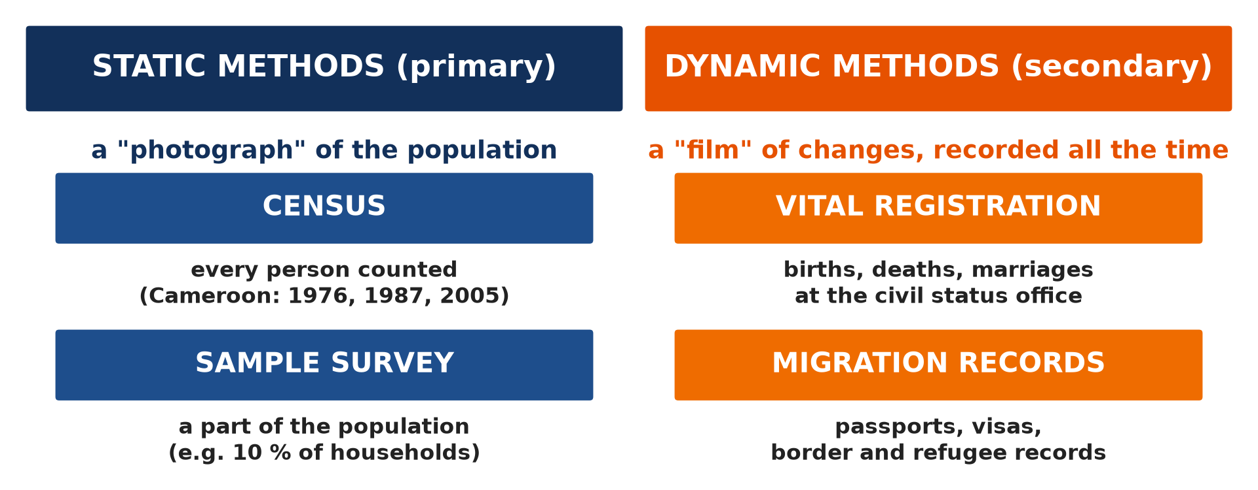
1. STATIC METHODS
Activity 1
Static and dynamic methods.
Notes:
Activity 1. Look carefully at this picture: static and dynamic methods. Observe every detail before I ask the question.

Slide 19
1. STATIC METHODS
Activity 1: Question
Which method gives a "photograph" of the whole population on one date?
Notes:
Here is the question for Activity 1: Which method gives a "photograph" of the whole population on one date? Take one minute to think and write your answer in your rough notebook.

Slide 20
1. STATIC METHODS
Activity 1: Answer
The census.
Notes:
Let us check the answer together. The census.

Slide 21
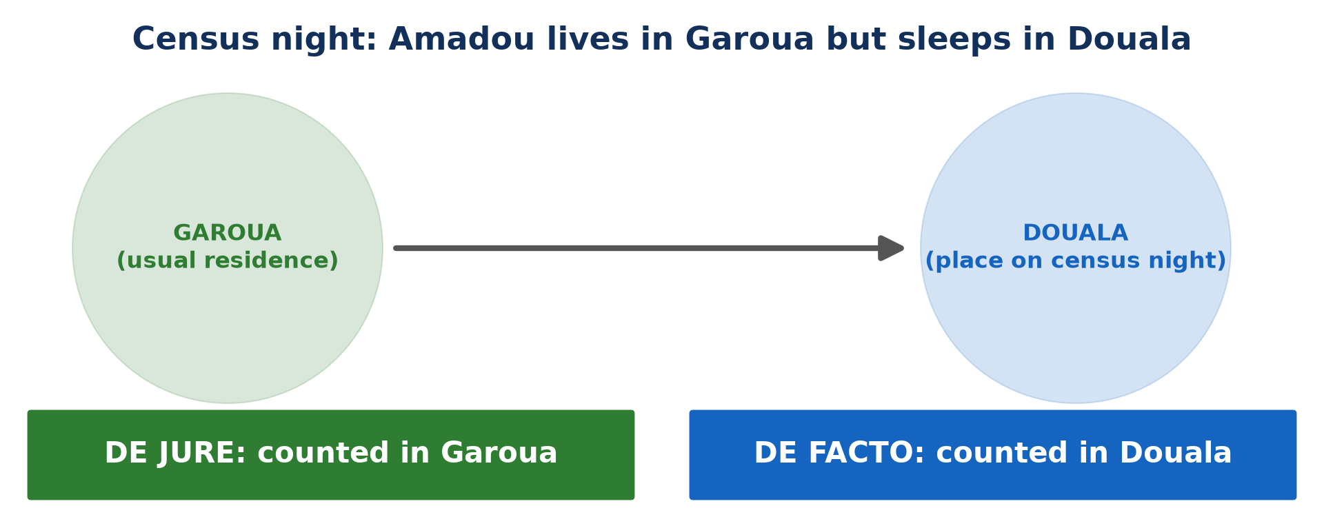
1. STATIC METHODS
Activity 2
Counted in Garoua or in Douala?
Notes:
Activity 2. Look carefully at this picture: counted in Garoua or in Douala?. Observe every detail before I ask the question.

Slide 22
1. STATIC METHODS
Activity 2: Question
Amadou lives in Garoua but sleeps in Douala on census night. Where is he counted with the de jure method?
Notes:
Here is the question for Activity 2: Amadou lives in Garoua but sleeps in Douala on census night. Where is he counted with the de jure method? Take one minute to think and write your answer in your rough notebook.

Slide 23
1. STATIC METHODS
Activity 2: Answer
In Garoua, his usual residence.
Notes:
Let us check the answer together. In Garoua, his usual residence.

Slide 24
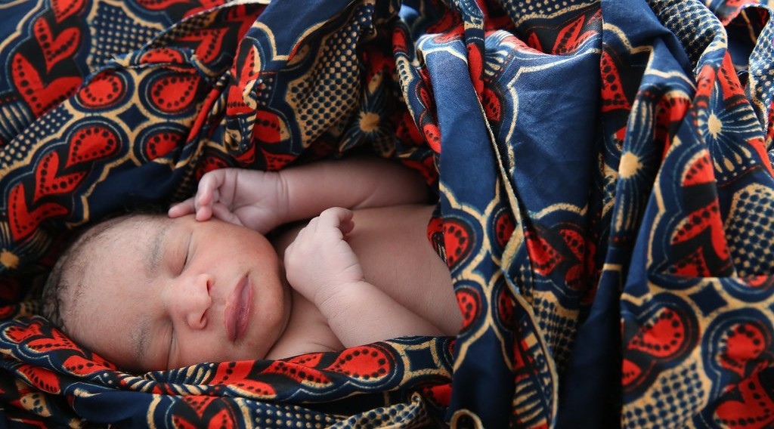
2. DYNAMIC METHODS
Activity 3
A newborn baby.
Notes:
Activity 3. Look carefully at this picture: a newborn baby. Observe every detail before I ask the question.

Slide 25
2. DYNAMIC METHODS
Activity 3: Question
Which dynamic method records this birth?
Notes:
Here is the question for Activity 3: Which dynamic method records this birth? Take one minute to think and write your answer in your rough notebook.

Slide 26
2. DYNAMIC METHODS
Activity 3: Answer
Vital registration (the civil status register).
Notes:
Let us check the answer together. Vital registration (the civil status register).

Slide 27
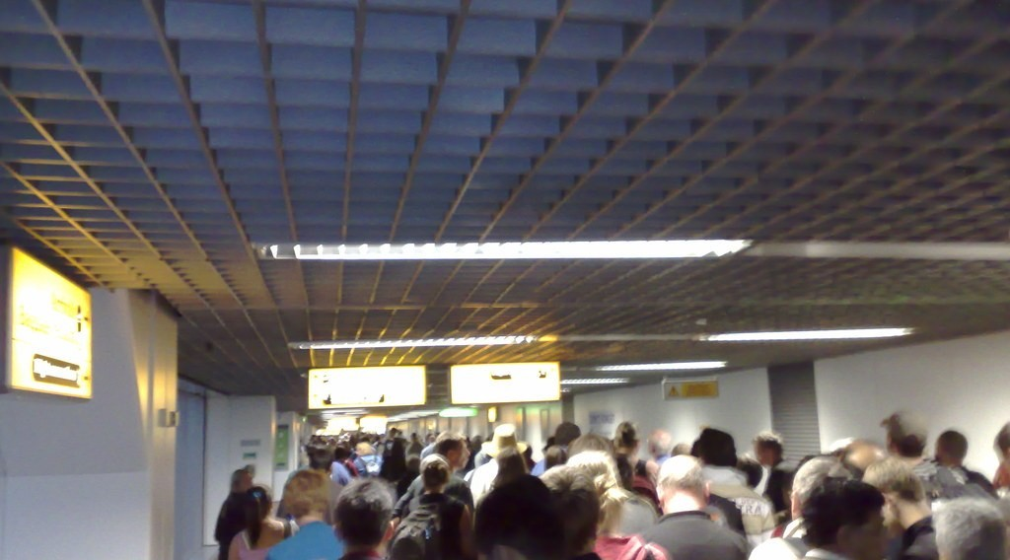
2. DYNAMIC METHODS
Activity 4
Travellers at an airport.
Notes:
Activity 4. Look carefully at this picture: travellers at an airport. Observe every detail before I ask the question.

Slide 28
2. DYNAMIC METHODS
Activity 4: Question
Why are migration records often unreliable in Africa?
Notes:
Here is the question for Activity 4: Why are migration records often unreliable in Africa? Take one minute to think and write your answer in your rough notebook.

Slide 29
2. DYNAMIC METHODS
Activity 4: Answer
Many people cross borders or move inside the country without being recorded.
Notes:
Let us check the answer together. Many people cross borders or move inside the country without being recorded.

Slide 30
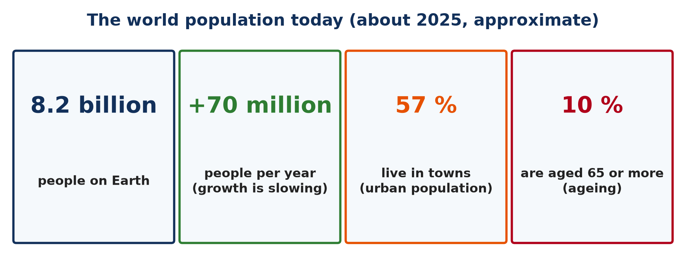
3. THE WORLD POPULATION TODAY
Activity 5
The world population today.
Notes:
Activity 5. Look carefully at this picture: the world population today. Observe every detail before I ask the question.

Slide 31
3. THE WORLD POPULATION TODAY
Activity 5: Question
About how many people live on Earth today?
Notes:
Here is the question for Activity 5: About how many people live on Earth today? Take one minute to think and write your answer in your rough notebook.

Slide 32
3. THE WORLD POPULATION TODAY
Activity 5: Answer
About 8.2 billion people.
Notes:
Let us check the answer together. About 8.2 billion people.

Slide 33
BOARD SUMMARY
Board Summary
Topic: Population Numbers
Sub-topic: Population Data
Lesson 1: Sources of Population Data
Notes:
Now we are going to copy the board summary. Write the title and the headings neatly in your notebooks. I will give you enough time for each slide, so do not rush.

Slide 34
BOARD SUMMARY
DEFINITIONS
The key terms of this lesson are defined as follows:
Population geography: It is the branch of geography that studies the distribution, composition, growth and movements of population in space and time.
Notes:
Let us copy the definitions. The key terms of this lesson are defined as follows. On this slide we have Population geography. Write each point on a new line, with the key term first, and explain it in your own words when we revise. When you finish, we go to the next slide.

Slide 35
BOARD SUMMARY
DEFINITIONS (continued)
Population: It is the total number of people living in a given area at a given time.
Population studies (demography): It is the scientific study of the size, structure and changes of human populations through births, deaths and migration.
Notes:
We continue with the definitions. On this slide we have Population and Population studies (demography). Write each point on a new line, with the key term first, and explain it in your own words when we revise. When you finish, we go to the next slide.

Slide 36
BOARD SUMMARY
DEFINITIONS (continued)
Census: It is the complete official count of all the people of a country or region at a given time.
Sample survey: It is the collection of data from a small part of the population chosen to represent the whole.
Notes:
We continue with the definitions. On this slide we have Census and Sample survey. Write each point on a new line, with the key term first, and explain it in your own words when we revise.

Slide 37
BOARD SUMMARY
1. Static Methods (Primary Sources)
A) The Census
The census has the following characteristics:
A snapshot: Static methods give a picture of the population at one moment, like a photograph.
Illustration: static and dynamic methods
Notes:
Let us copy The Census. The census has the following characteristics. Copy the point on A snapshot on the left, then draw the diagram on the right: static and dynamic methods. Give it a title and label it clearly.

Slide 38

BOARD SUMMARY
1. Static Methods (Primary Sources)
A) The Census
Complete count: The census counts every person and records age, sex, marital status, education, occupation and residence.
Illustration: every person is counted
Notes:
Copy the point on Complete count on the left, then draw the diagram on the right: every person is counted. Give it a title and label it clearly.

Slide 39
BOARD SUMMARY
1. Static Methods (Primary Sources)
A) The Census
Frequency: It is normally held every ten years; Cameroon held censuses in 1976, 1987 and 2005, and the 2005 census counted 17,463,836 people.
Notes:
We continue with The Census. On this slide we have Frequency. Write each point on a new line, with the key term first, and explain it in your own words when we revise. When you finish, we go to the next slide.

Slide 40
BOARD SUMMARY
1. Static Methods (Primary Sources)
A) The Census (continued)
Cost and delays: It is the most complete source but also the most expensive, so it is often delayed in developing countries.
Organisation: In Cameroon, the census is organised by BUCREP (Bureau Central des Recensements et des Études de Population).
Notes:
We continue with The Census. On this slide we have Cost and delays and Organisation. Write each point on a new line, with the key term first, and explain it in your own words when we revise.

Slide 41
BOARD SUMMARY
1. Static Methods (Primary Sources)
B) De Facto and De Jure Censuses
The two methods of counting people in a census are the following:
De facto method: People are counted where they are found on census night, even if they are only visiting.
Illustration: de facto and de jure
Notes:
Let us copy De Facto and De Jure Censuses. The two methods of counting people in a census are the following. Copy the point on De facto method on the left, then draw the diagram on the right: de facto and de jure. Give it a title and label it clearly.

Slide 42
BOARD SUMMARY
1. Static Methods (Primary Sources)
B) De Facto and De Jure Censuses
Example of de facto: Britain used it for a long time; a Garoua trader sleeping in Douala on census night is counted in Douala.
De jure method: People are counted at their usual place of residence, wherever they are on census night.
Notes:
We continue with De Facto and De Jure Censuses. On this slide we have Example of de facto and De jure method. Write each point on a new line, with the key term first, and explain it in your own words when we revise. When you finish, we go to the next slide.

Slide 43
BOARD SUMMARY
1. Static Methods (Primary Sources)
B) De Facto and De Jure Censuses (continued)
Example of de jure: It is used in the USA and in Cameroon; the Garoua trader is counted in Garoua.
Notes:
We continue with De Facto and De Jure Censuses. On this slide we have Example of de jure. Write each point on a new line, with the key term first, and explain it in your own words when we revise. When you finish, we go to the next slide.

Slide 44
BOARD SUMMARY
1. Static Methods (Primary Sources)
B) De Facto and De Jure Censuses (continued)
Problems: The de facto method can count visitors twice, while the de jure method has difficulties with homeless people and people with two homes.
Notes:
We continue with De Facto and De Jure Censuses. On this slide we have Problems. Write each point on a new line, with the key term first, and explain it in your own words when we revise.

Slide 45
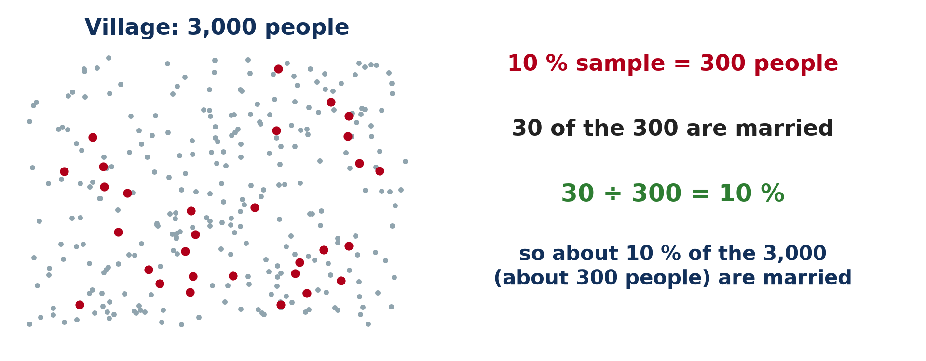
BOARD SUMMARY
1. Static Methods (Primary Sources)
C) Sample Surveys
Sample surveys have the following characteristics:
Principle: Data are collected from a representative part of the population, and the results are extended to the whole population.
Illustration: a 10 % sample
Notes:
Let us copy Sample Surveys. Sample surveys have the following characteristics. Copy the point on Principle on the left, then draw the diagram on the right: a 10 % sample. Give it a title and label it clearly.

Slide 46
BOARD SUMMARY
1. Static Methods (Primary Sources)
C) Sample Surveys
Worked example: In a village of 3,000 people, a 10 % sample is 300 people; if 30 of them are married (10 %), about 300 people of the village are married.
Notes:
We continue with Sample Surveys. On this slide we have Worked example. Write each point on a new line, with the key term first, and explain it in your own words when we revise. When you finish, we go to the next slide.

Slide 47
BOARD SUMMARY
1. Static Methods (Primary Sources)
C) Sample Surveys (continued)
Sampling methods: Random and systematic sampling are used so that every person has a fair chance of being chosen.
Notes:
We continue with Sample Surveys. On this slide we have Sampling methods. Write each point on a new line, with the key term first, and explain it in your own words when we revise. When you finish, we go to the next slide.

Slide 48
BOARD SUMMARY
1. Static Methods (Primary Sources)
C) Sample Surveys (continued)
Examples: The Demographic and Health Surveys (EDS) and the household surveys of the INS (Institut National de la Statistique) in Cameroon.
Notes:
We continue with Sample Surveys. On this slide we have Examples. Write each point on a new line, with the key term first, and explain it in your own words when we revise. When you finish, we go to the next slide.

Slide 49
BOARD SUMMARY
1. Static Methods (Primary Sources)
C) Sample Surveys (continued)
Strength and weakness: They are cheaper and faster than a census, but a badly chosen sample gives wrong results.
Notes:
We continue with Sample Surveys. On this slide we have Strength and weakness. Write each point on a new line, with the key term first, and explain it in your own words when we revise.

Slide 50
BOARD SUMMARY
2. Dynamic Methods (Secondary Sources)
The dynamic methods of collecting population data are the following:
Continuous recording: Dynamic methods record changes in the population as they happen, like a film.
Notes:
Let us copy Dynamic Methods (Secondary Sources). The dynamic methods of collecting population data are the following. On this slide we have Continuous recording. Write each point on a new line, with the key term first, and explain it in your own words when we revise.

Slide 51
BOARD SUMMARY
2. Dynamic Methods (Secondary Sources)
Vital registration: It records births, deaths, marriages, divorces and adoptions at the civil status office.
Illustration: every birth should be registered
Notes:
Copy the point on Vital registration on the left, then draw the diagram on the right: every birth should be registered. Give it a title and label it clearly.

Slide 52
BOARD SUMMARY
2. Dynamic Methods (Secondary Sources)
Reliability of vital registration: It is complete and accurate in developed countries, but in Cameroon many births and deaths in villages are never declared.
Notes:
We continue with Dynamic Methods (Secondary Sources). On this slide we have Reliability of vital registration. Write each point on a new line, with the key term first, and explain it in your own words when we revise.

Slide 53
BOARD SUMMARY
2. Dynamic Methods (Secondary Sources)
Migration records: Passports, visas, residence permits, border and refugee records show movements into and out of a country.
Illustration: migration records at an airport
Notes:
Copy the point on Migration records on the left, then draw the diagram on the right: migration records at an airport. Give it a title and label it clearly.

Slide 54
BOARD SUMMARY
2. Dynamic Methods (Secondary Sources)
Reliability of migration records: Internal movements are rarely recorded, and many people cross African borders informally, so these records are incomplete.
Notes:
We continue with Dynamic Methods (Secondary Sources). On this slide we have Reliability of migration records. Write each point on a new line, with the key term first, and explain it in your own words when we revise.

Slide 55
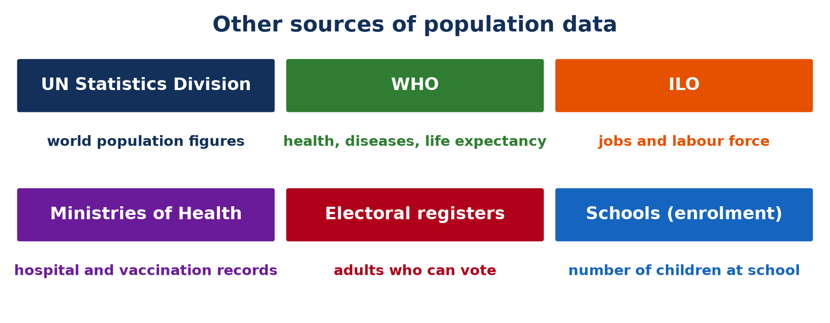
BOARD SUMMARY
3. Other Sources of Population Data
Other sources of population data are the following:
International organisations: The United Nations Statistics Division publishes population figures for all countries.
Illustration: other sources of population data
Notes:
Let us copy Other Sources of Population Data. Other sources of population data are the following. Copy the point on International organisations on the left, then draw the diagram on the right: other sources of population data. Give it a title and label it clearly.

Slide 56
BOARD SUMMARY
3. Other Sources of Population Data
Specialised agencies: The WHO gives data on health and life expectancy, and the ILO gives data on jobs and the labour force.
National ministries: The Ministries of Health and Education give hospital, vaccination and school enrolment records.
Notes:
We continue with Other Sources of Population Data. On this slide we have Specialised agencies and National ministries. Write each point on a new line, with the key term first, and explain it in your own words when we revise. When you finish, we go to the next slide.

Slide 57
BOARD SUMMARY
3. Other Sources of Population Data (continued)
Electoral registers: They show the number and distribution of adults who can vote.
Notes:
We continue with Other Sources of Population Data. On this slide we have Electoral registers. Write each point on a new line, with the key term first, and explain it in your own words when we revise.

Slide 58
BOARD SUMMARY
4. The Current State of the World Population
The world population today can be described as follows:
Size: The world population passed 8 billion in 2022 and is about 8.2 billion today.
Illustration: the world population today
Notes:
Let us copy The Current State of the World Population. The world population today can be described as follows. Copy the point on Size on the left, then draw the diagram on the right: the world population today. Give it a title and label it clearly.

Slide 59
BOARD SUMMARY
4. The Current State of the World Population
Slower growth: It still grows by about 70 million people a year, but the growth rate is falling.
Notes:
We continue with The Current State of the World Population. On this slide we have Slower growth. Write each point on a new line, with the key term first, and explain it in your own words when we revise.

Slide 60
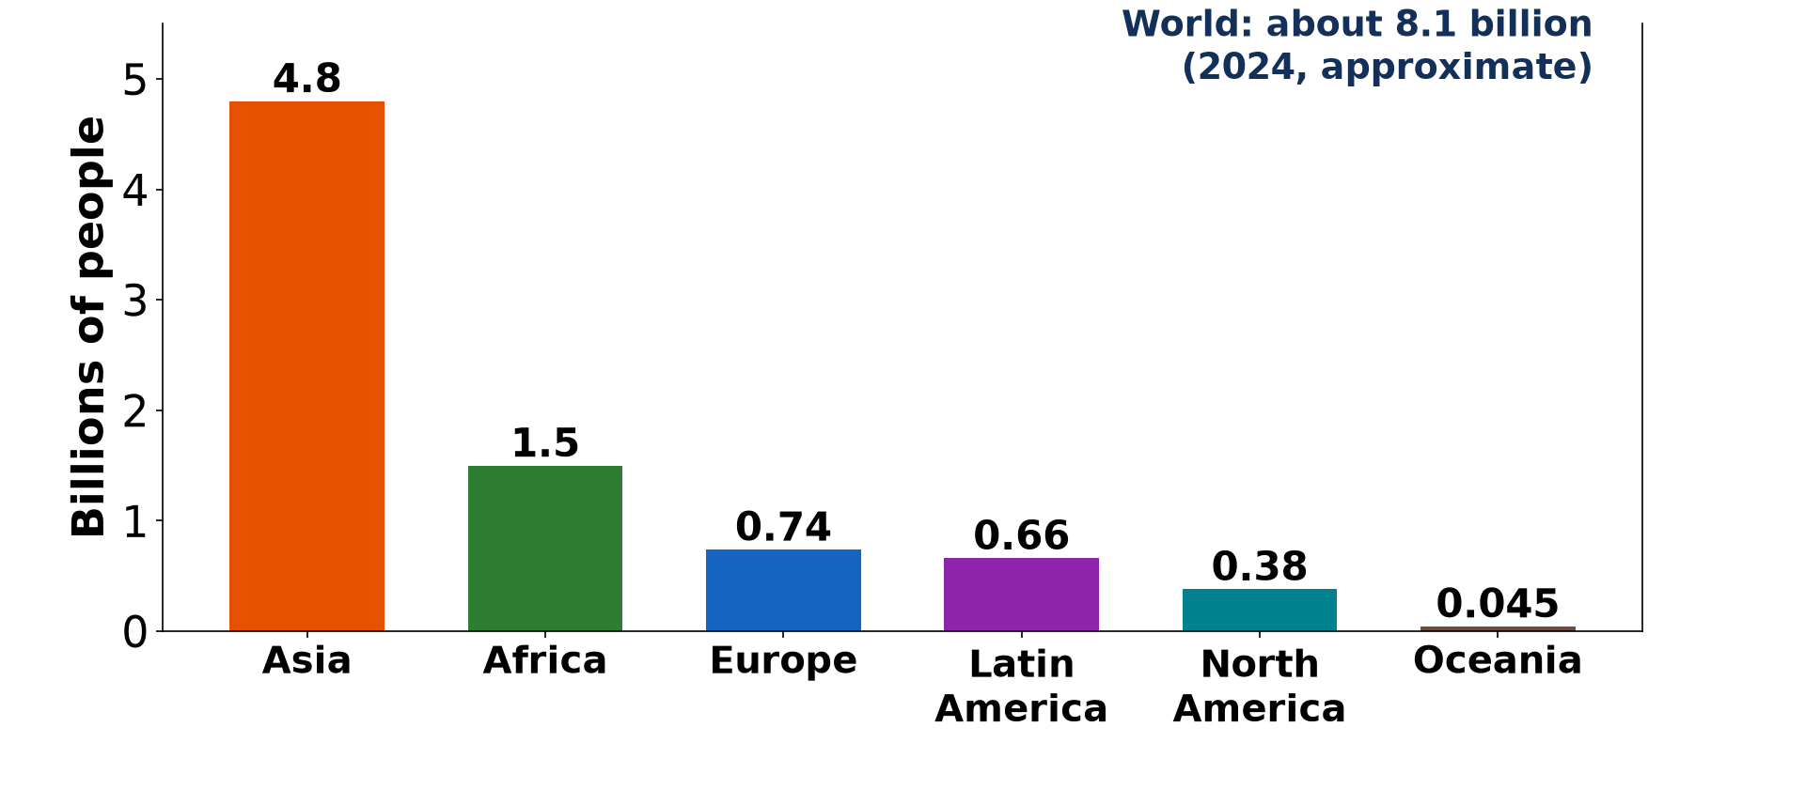
BOARD SUMMARY
4. The Current State of the World Population
Contrasts: Developed countries have low birth rates and ageing populations, while developing countries, especially in Africa, have high birth rates and young populations.
Illustration: world population by continent
Notes:
Copy the point on Contrasts on the left, then draw the diagram on the right: world population by continent. Give it a title and label it clearly.

Slide 61
BOARD SUMMARY
4. The Current State of the World Population
Urbanisation: More than half of the world population (about 57 %) lives in towns, and cities grow fastest in Asia and Africa.
Migration: Migration increases the population of receiving countries such as the USA and Germany and reduces that of sending countries.
Notes:
We continue with The Current State of the World Population. On this slide we have Urbanisation and Migration. Write each point on a new line, with the key term first, and explain it in your own words when we revise.

Slide 62
FORMATIVE EVALUATION
Evaluation 1
Distinguish between the de facto and the de jure methods of census.
Notes:
Now let us check what you have understood. Question 1: Distinguish between the de facto and the de jure methods of census. Answer in your exercise book.

Slide 63
FORMATIVE EVALUATION
Expected Answer
The de facto method counts people where they are on census night; the de jure method counts them at their usual residence.
Notes:
The expected answer is: the de facto method counts people where they are on census night; the de jure method counts them at their usual residence. If you got it right, well done.

Slide 64
FORMATIVE EVALUATION
Evaluation 2
Give two reasons why vital registration is incomplete in Cameroon.
Notes:
Now let us check what you have understood. Question 2: Give two reasons why vital registration is incomplete in Cameroon. Answer in your exercise book.

Slide 65
FORMATIVE EVALUATION
Expected Answer
Many births take place at home far from civil status offices, and many people do not know the importance of declaring births and deaths.
Notes:
The expected answer is: many births take place at home far from civil status offices, and many people do not know the importance of declaring births and deaths. If you got it right, well done.

Slide 66
REMEDIATION
Remediation
Fill in the blanks:
A ______ counts every person of a country at a given time.
Births and deaths are recorded by ______ registration.
Notes:
Take your time to copy this part; we will continue together.

Slide 67
REMEDIATION
Remediation (continued)
The last census of Cameroon took place in ______.
Notes:
For those who need more practice, fill in the blanks in your exercise book. The answers are: number 1, census; number 2, vital; number 3, 2005.

Slide 68
HOMEWORK
Homework
Define population density.
Notes:
For your homework: Define population density. We shall correct it at the beginning of our next lesson.

Slide 69
NEXT LESSON
Next Lesson
Our next lesson will be on:
Lesson 2: Population Distribution and Density
Notes:
Our next lesson will be on Lesson 2: Population Distribution and Density. Thank you for your attention, and see you next time.

Slide 70
BILINGUAL GAME
Bilingual Game (Jeu Bilingue)
English | Français
Census | Le recensement
Sample survey | L'enquête par sondage
Vital registration | L'état civil
Birth certificate | L'acte de naissance
Population studies | La démographie
Usual residence | La résidence habituelle
Notes:
Let us play the bilingual game. I say a word in English, and you give me the French word. Then we do the reverse.

Slide 71
LOGBOOK
Official Logbook (1/2)
Module / Topic | Population Numbers
Lesson Title | Lesson 1: Sources of Population Data
Expected Learning Outcomes | Define population geography, population and population studies. Describe the static methods of collecting population data. Describe the dynamic methods of collecting population data. Name other sources of population data. Describe the current state of the world population.
Competence | Learners are able to identify the sources of population data, compare their strengths and weaknesses and describe the present state of the world population.
Notes:
I record this information in the official logbook of the class after the lesson.

Slide 72
LOGBOOK
Official Logbook (2/2)
Matter Taught | DEFINITIONS; The Census; De Facto and De Jure Censuses; Sample Surveys; Dynamic Methods (Secondary Sources); Other Sources of Population Data; The Current State of the World Population.
Evaluation | Formative evaluation and remediation exercise.
Homework | Define population density.
Enrolment / Present / Absent | ____ / ____ / ____
Achievement | To be completed after the lesson.
Notes:
I complete the second page of the logbook: the matter taught, the evaluation, the homework and the attendance.

Slide 73
TEACHER'S NOTE
Teacher's Note
Timing: Homework correction, plan, objectives 8 min | Recall, situation, action 10 min | 5 activities 30 min | Board summary (copying) 30 min | Evaluation, remediation 10 min | Homework, next lesson 5 min | Logbook 7 min
Without the projector (Activity 1): draw the two columns on the board.
Without the projector (Activity 2): tell the story of Amadou.
Without the projector (Activity 3): ask who has a birth certificate.
Without the projector (Activity 4): describe a border post such as Kousseri.
Without the projector (Activity 5): write the four figures on the board.
Notes:
This slide is for me, the teacher: it gives the timing of the lesson and what to do if the projector is not available.

Slide 74
REFERENCES
References
Geography Syllabus for Sixth Forms (Lower and Upper Sixth), MINESEC, 2019 — Module 4 (Population Geography).
Teacher's course notes: Mr KAMDEM E., Population Geography (USA), GBHS Garoua, 2026.
United Nations, World Population Prospects 2024.
Photo, Activity 3: “Newborn baby rests” by World Bank Photo Collection, CC BY-NC-ND 2.0, via Flickr (https://www.flickr.com/photos/10816734@N03/19845580540)
Photo, Activity 4: “London Heathrow T4 arrivals” by markhillary, CC BY 2.0, via Flickr (https://www.flickr.com/photos/56087830@N00/1568955656)
Photo, board summary (Complete count): “Wax market” by zouzouwizman, CC BY 2.0, via Flickr (https://www.flickr.com/photos/61111202@N00/12129001)
Diagrams and animations: drawn for this lesson (Geography Department).
Notes:
These are the references and picture credits used to prepare this lesson.

